Slide 1
Machine Learning for Java migrations
HUAWEI TECHNOLOGIES CO. LTD (Russia)
Mr. Zorchenkov
2020-12-05

Slide 2

Content:
Self-introduction
Project idea, Added value
TF IDF explained
Machine learning in API migration

Slide 3
Self-introduction
Name: ALEXEY ZORCHENKOV
Huawei ID: z0534010
Rep. Office: Moscow City, Federation Tower 14th floor
Department : Moscow System Programming Laboratory
Position: Principal engineer
Enrollment Date: 2019-09-09

Slide 4






Experience Before Joining Huawei
Moscow State university
Master in theoretical physics, 5.5 years
Master in mathematics, differential equations, 5 years
Post graduate education, theoretical mechanics, 3 years
Publications in Russian financial magazines

Slide 5
Added value created
Integrated Machine Learning Algorithms in API migration tool
Implemented independent REST API service to compute high precision similarities between API migrated functions documentations used to fine tune API migration results

Slide 6

Term-frequency times inverse document-frequency
For term t in document d:
tf-idf(t, d) = tf(t, d) * idf(t)
idf(t) = log [ n / df(t) ] + 1, where n is the total number of documents in the document set and df(t) is the document frequency of t; the document frequency is the number of documents in the document set that contain the term t

Slide 7
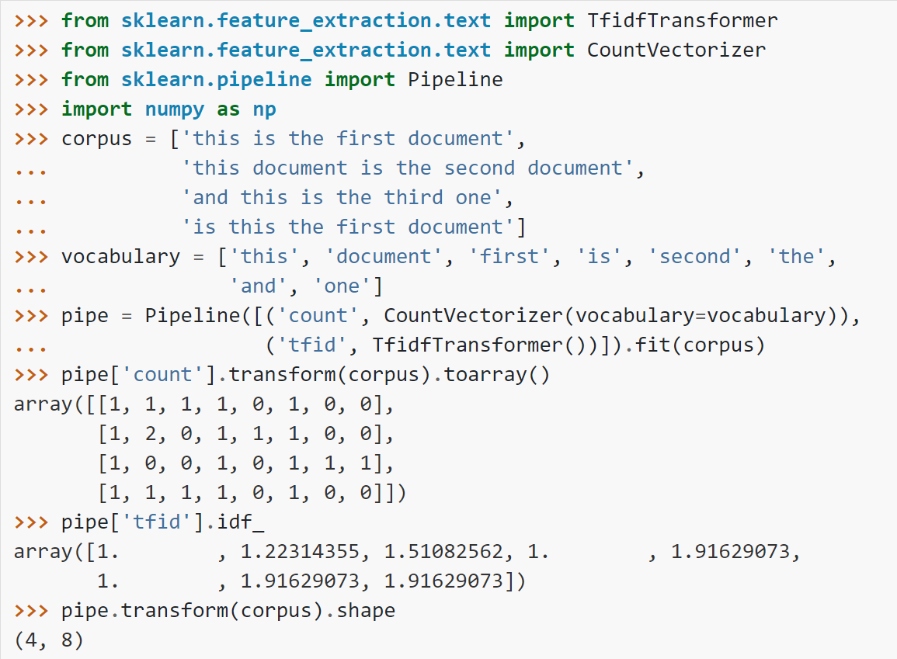

Slide 8
Cosine similarity
K(X, Y) = <X, Y> / (||X||*||Y||)

Slide 9
Applied ML in API migration
Input:
1st function description
2nd function description
Trained ML model + dictionary
1st function description coordinates
2nd function description coordinates
Out: Cosine Similarity
Select most closest function for API migration

Slide 10
Applied TF IDF in API migration
double SimilarDegree =
nlpWebService.getCosineSimilarity(methodFromDocs.description,
methodToDocs.description) * 100;
If we have one of the function in another mapping and if found with high similar we will ignore new mapping but if found with lower similar we will update new mapping with existing one

